Slide 1
Bastion host: apache guacamole
Securely access your back-end instances with a web-based bastion host!
…You’re not leaving them in public subnets with ssh open, right?

Slide 2
Content
1
The Past: On-Premise Datacenter
2
Jumping to the Future: Cloud
3
Future and Beyond: ZeroTrust
4
Remote access? Welcome Bastion
5
Meet Guacamole: HTML5, clientless Remote Desktop Gateway
6
Overview: Infrastructure and Terraform
7
Live Demo! Links and Q&A

Slide 3
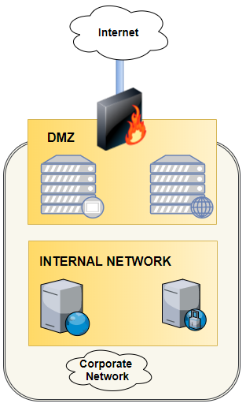
The Past: On-premise dc
Edge firewall, maybe with a DMZ with exposed public services and/or load balancer
Internal Network is «Trusted» by default (epic misconception from the ancient times)
Remote access is managed through VPN

Slide 4
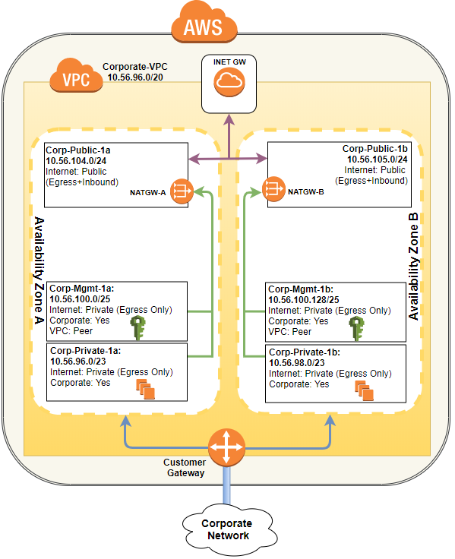
Jumping to the future: cloud
Move to AWS
VPC with Corporate back-end connectivity
Remote access to private subnets is allowed only through corp network

Slide 5
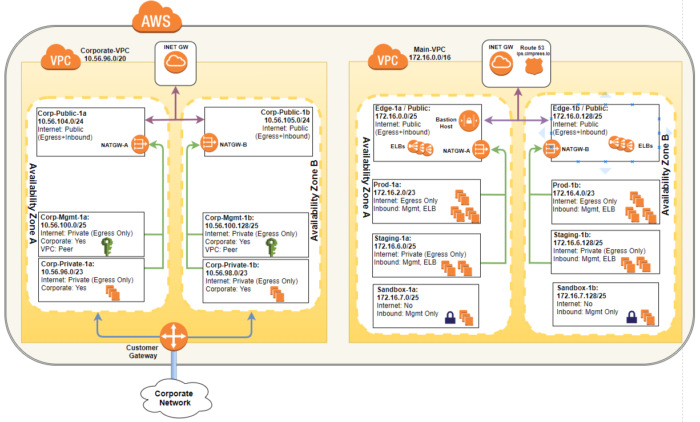
Future and beyond: zero trust
…Goodbye, corporate network!

Slide 6
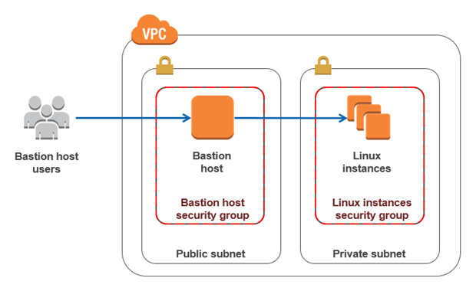
Remote access? Welcome bastion
Key Needs:
Reach our private instances from anywhere in the world
Multifactor Authentication
Scalable, highly-available and repeatable
Solution: Apache Guacamole!

Slide 7

Meet the bastion 2.0:
Key Features:
Clientless, HTML5 Web Application
Running on Tomcat + guacd service (remote connections daemon)
Supports SSH, RDP, VNC and Multifactor Auth (DUO)
Deployed in AWS through Terraform:
Autoscaling groups + multiple availability zones
Created as a module, re-usable and automated deployment
Open Source!

Slide 8
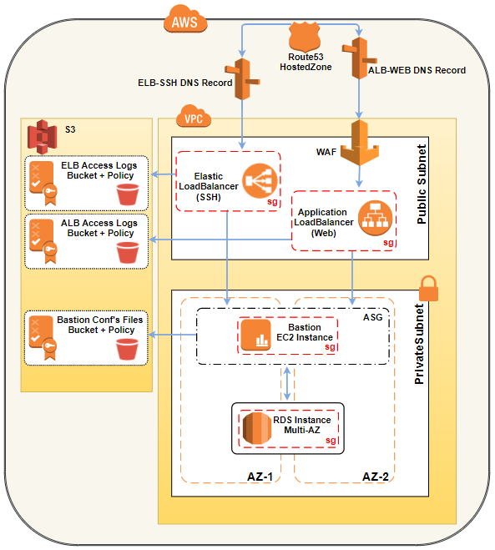
Overview: Infrastructure
And terraform
2x Load Balancers in Public Subnets:
Web Interface (ALB) + SSH (ELB – on custom port!)
Access Logs are shipped to dedicated S3 buckets
WAF in front of Application Load Balancer, leveraging AWS WAF Security Automations CloudFormation Stack
EC2 instances running the web app in the private subnets, under Autoscaling Group
Configuration files are stored in an S3 bucket, and retrieved at boot-time through user-data script together with initial DB schema checks/config.
RDS / MySQL back-end in Multi-AZ

Slide 9

Live Demo, links and q&a
Cimpress Bastion Host:
https://barbican.ips.cimpress.io/guacamole/#/
GitHub Repo:
https://github.com/Cimpress-MCP/IPS_Bastion_Guacamole
Official Apache Guacamole Page:
https://guacamole.apache.org/

